Slide 1
CASCADING STYLE SHEETS
CSS

Slide 2
AGENDA

Slide 3
Agenda PART 1
Overview to CSS and its syntax
Ways of inserting CSS on a web page
Basic Selectors (element, id, class)
CSS Text & Font Modules
Cascade, Specificity & Inheritance
Colors
Advance Selectors
Box Model
Unit of measurements
Styling Images
Backgrounds

Slide 4
Agenda PART 2
CSS Page Layouts & Grids
Positioning
Styling Forms
Responsive Design
Animation

Slide 5

WEB PAGE
A web page is an electronic document. They are files that are stored on a computer that runs software called a web server and retrieve via a program called a browser.

Slide 6

MAIN FRONT-END TECHNOLOGIES

Slide 7
CSS
CSS is the acronym for Cascading Style Sheets. It is a language used for specifying how documents are presented to users and how they are styled, laid out, etc
For example, to alter the font, color, size, and spacing of your content, split it into multiple columns, or add animations and other decorative features

Slide 8
A WEB PAGE WITH CSS

Slide 9


Slide 10
A WEBPAGE WITHOUT CSS

Slide 11
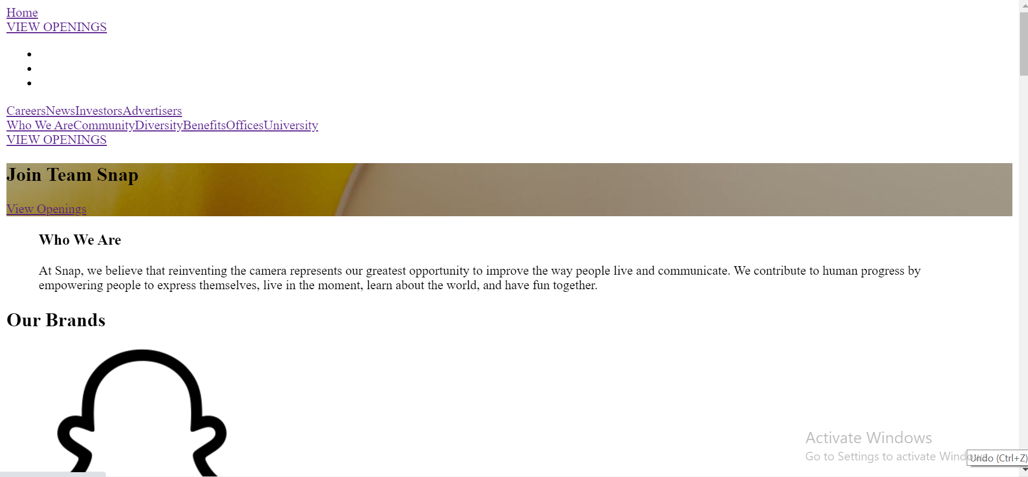

Slide 12

CSS IS ALL ABOUT RULES

Slide 13
CSS RULES
CSS is a rule-based language.
You define rules specifying groups of styles that should be applied to particular elements or groups of elements on your web page.
For example
"I want the main heading on my page to be shown as large blue text."
“I want all my paragraphs center aligned
“I want all my images to have a border”
“I want a specific paragraph to be a particular font”

Slide 14
ECOSYSTEM AND SYNTAX OF CSS

Slide 15
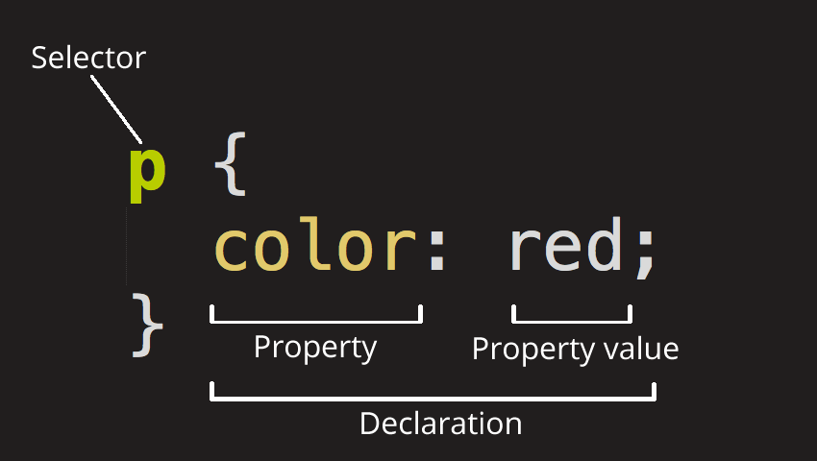
CSS Rule
Selector- It is a word and or pattern that selects the element(s) to be styled.
Declaration-A single rule like color: red; specifying which of the element's properties you want to style.
Properties-Ways in which you can style a given HTML element. In CSS, you choose which properties you want to affect in your rule.
Property value-To the right of the property, after the colon, we have the property value, which chooses one out of many possible appearances for a given property.

Slide 16
THE WAYS TO INSERT CSS ON A WEB PAGE

Slide 17
WAYS TO INSERT CSS ON A WEB PAGE
Inline CSS
Internal CSS
External CSS

Slide 18
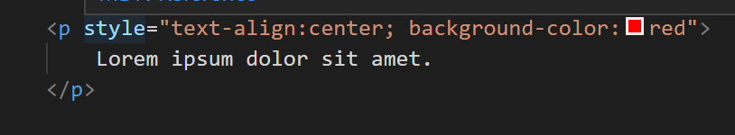
INLINE CSS
An inline style may be used to apply a unique style for a single element.
To use inline styles, add the style attribute to the relevant element. The style attribute can contain any CSS property.

Slide 19
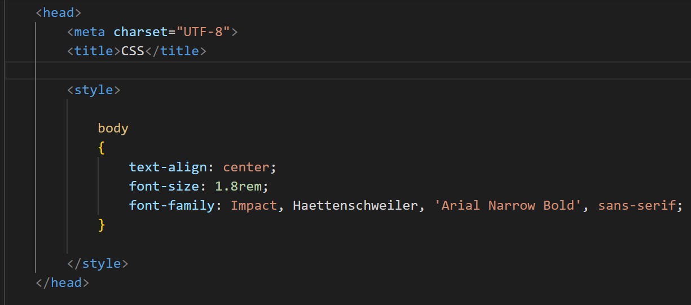
INTERNAL CSS
An internal style sheet may be used if one single HTML page has a unique style.The internal style is defined inside the <style> element, inside the head section.

Slide 20
EXTERNAL CSS
With an external style sheet, you can change the look of an entire website by changing just one file!
Each HTML page must include a reference to the external style sheet file inside the <link> element, inside the head section.

Slide 21
SELECTOR
It is a word and or pattern that selects the element(s) to be styled from an HTML document.

Slide 22
TYPES OF SELECTORS
Simple selectors - Select elements based on element, id, class
Universal Selector - The universal selector (*) selects all HTML elements on the page select and style a part of an element
Attribute selector - select elements based on an attribute or attribute value.
Combinators- select elements based on a specific relationship between selectors.
Pseudo-class selector - select elements based on a certain state.
Pseudo-elements selectors -select and style a part of an element

Slide 23
SIMPLE SELECTOR

Slide 24
ELEMENT SELECTOR
The element selector selects HTML elements based on the element name.

Slide 25
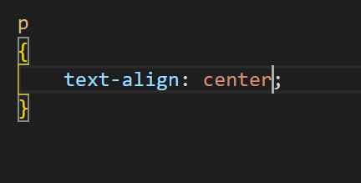
Element Selector
This selector selects all paragraph tags.

Slide 26
ID SELECTOR
The id selector uses the id attribute of an HTML element to select a specific element.

Slide 27
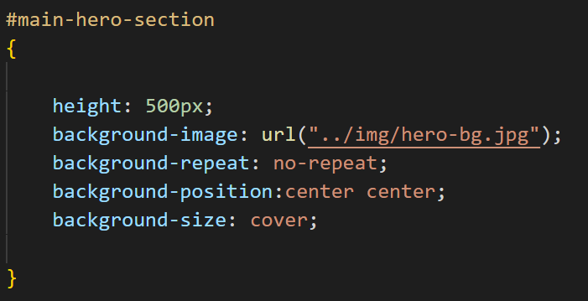
ID Selector
This selector selects the element with the id main-hero-section

Slide 28
CLASS SELECTOR
The class selector uses the class attribute of HTML elements to select a group of specific elements.

Slide 29
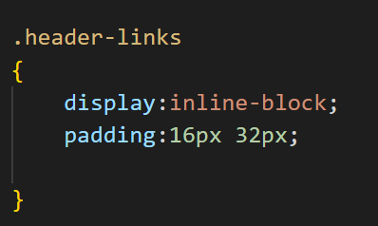
Class Selector
This selector selects the elements that have the class .header-links

Slide 30
CSS MODULES
CSS, the language is broken down into modules.

Slide 31
CSS TEXT
CSS Text includes setting font, boldness, italics, line and letter spacing, drop shadows, and other text features.

Slide 32
TEXT PROPERTIES
color
text-align
text-decoration
text-transformation
line-height
letter-spacing
word spacing

Slide 33
CSS FONTS
The CSS font properties define the font family, boldness, size, and the style of a text.

Slide 34
FONT PROPERTIES
font-weight
font-style
font-family
font-size
Google Fonts

Slide 35
MORE SELECTORS

Slide 36
TYPES OF SELECTORS
Simple selectors - Select elements based on element, id, class
Universal Selector - The universal selector (*) selects all HTML elements on the page select and style a part of an element
Attribute selector - select elements based on an attribute or attribute value.
Combinators- select elements based on a specific relationship between selectors.
Pseudo-class selector - select elements based on a certain state.
Pseudo-elements selectors -select and style a part of an element

Slide 37
ATTRIBUTE SELECTOR
Styles HTML elements with specific attributes and/or attribute values.

Slide 38
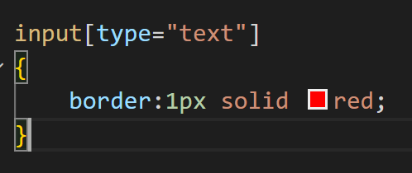
Attribute Selector
This selector selects all input tags that have the attribute type and the value text

Slide 39
PSEUDO-CLASSES
A pseudo-class selector is used to define a special state of an element.

Slide 40
PSEUDO- CLASSES
It can be used to:
Style an element when a user mouses over it
Style visited and unvisited links differently
Style an element when it gets focus
https://developer.mozilla.org/en-US/docs/Web/CSS/Pseudo-classes

Slide 41
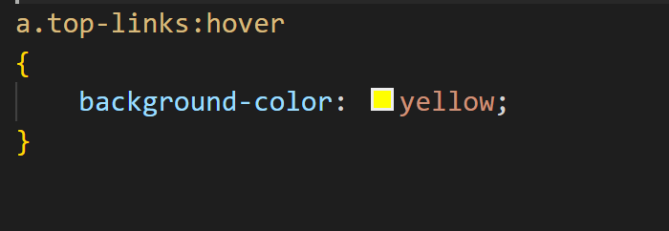
PSEDUO-CLASSES
This selector selects all the links that have a class called “top-links” with a hover state

Slide 42
PSEUDO-ELEMENTS
A CSS pseudo-element is used to style specified parts of an element.

Slide 43
PSEUDO- ELEMENTS
It can be used to:
Style the first letter, or line, of an element
Insert content before, or after, the content of an element
https://developer.mozilla.org/en-US/docs/Web/CSS/Pseudo-elements

Slide 44
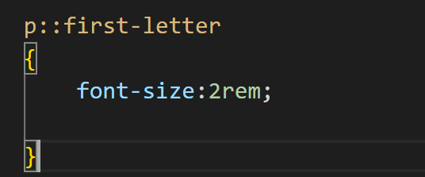
PSEUDO-ELEMENTS
This selector selects the first-letter in ever paragraph

Slide 45
COMBINATOR SELECTORS

Slide 46
Combinators
There are four different combinators in CSS:
descendant selector (space)
child selector (>)
adjacent sibling selector (+)
general sibling selector (~)

Slide 47
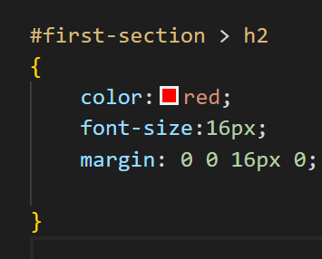
Child Selector
selector > selector
{ }
The child selector matches all elements that are children of a specified element.
The example selects all <h2> elements that are children elements of an element with an id first-section:

Slide 48
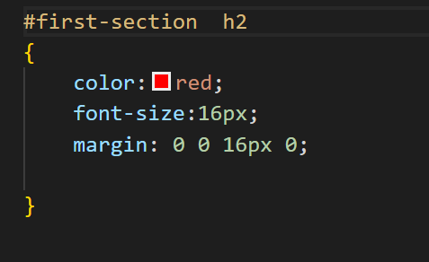
Descendant Selector
selector > selector
{ }
The descendant selector matches all elements that are descendants of a specified element.
The example selects all <h2> elements inside an element with the id first-section:

Slide 49
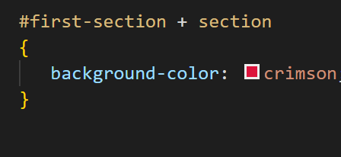
Adjacent Sibling Selector
The adjacent sibling selector selects all elements that are the adjacent siblings of a specified element.
Sibling elements must have the same parent element, and "adjacent" means "immediately following".
The following example selects all <section> elements that are placed immediately after the element with an id first-section:

Slide 50
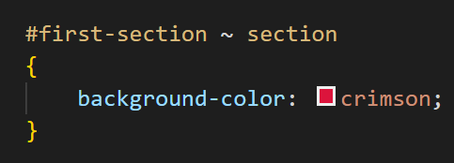
General Sibling Selector
The general sibling selector selects all elements that are siblings of a specified element.
The following example selects all <section> elements that are siblings of an element with an id first-section:

Slide 51
SPECIFICITY
Specificity is how the browser decides which rule applies if multiple rules have different selectors, but could still apply to the same element. It is basically a measure of how specific a selector's selection will be

Slide 52
SPECIFICITY
Every selector has its place in the specificity hierarchy. There are four categories which define the specificity level of a selector:
Inline styles - An inline style is attached directly to the element to be styled. Example: <h1 style="color: #ffffff;">.
IDs - An ID is a unique identifier for the page elements, such as #navbar.
Classes, attributes and pseudo-classes - This category includes .classes, [attributes] and pseudo-classes such as :hover, etc.
Elements and pseudo-elements - This category includes element names and pseudo-elements, such as h1, div, ::first-letter and :after.

Slide 53
CASCADE
The order of CSS rules matter; when two rules apply that have equal specificity the one that comes last in the CSS is the one that will be used.

Slide 54
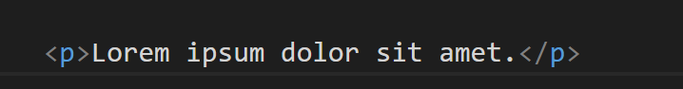
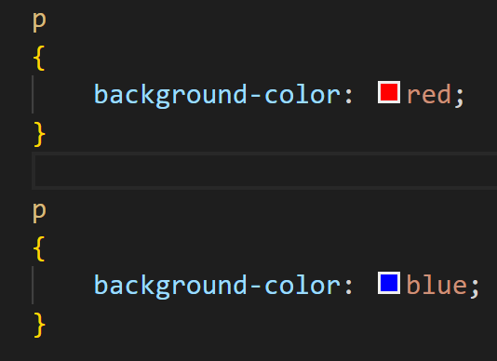
In the this example, we have two rules that could apply to the p.
The p ends up being colored blue because these rules have an identical selector and therefore carry the same specificity, so the last one in the code order wins.

Slide 55
INHERITANCE
The mechanism through which the value of certain properties is passed on from parent elements to child elements is called inheritance.

Slide 56
How is Inheritance is useful
CSS Inheritance greatly reduces the time and effort required to create a website.
Imagine how much CSS you would have to write to set the color on all children of the body tag.
This would be time consuming, error prone, and difficult to maintain.
Similarly, you can imagine what a nightmare it would be if you were forced to set the font-family or font-size on every child element of a container.

Slide 57
HOW IS INHERITANCE IS USEFUL?

Slide 58
How is Inheritance is useful
CSS Inheritance greatly reduces the time and effort required to create a website.
Imagine how much CSS you would have to write to set the color on all children of the body tag.
This would be time consuming, error prone, and difficult to maintain.
Similarly, you can imagine what a nightmare it would be if you were forced to set the font-family or font-size on every child element of a container.

Slide 59
Only certain properties are inherited
In real life, not all attributes of parents are passed on to their children.
The same is true in CSS; not every CSS property is inherited by default by child elements.
In fact, if all properties were inherited, the effect would be similar to having no inheritance at all and you would have to write a lot of CSS to override this behavior.
If the border property was inheritable, setting a border on a single element would cause the same border to appear on all its child elements.
Similarly, if children inherited the background-image property from their parents, the result would be messy.

Slide 60
Some Inheritable properties
color
font-weight
font-style
text-transform
text-align
text-decoration
letter-spacing
word-spacing
line-height

Slide 61
BOX MODEL

Slide 62
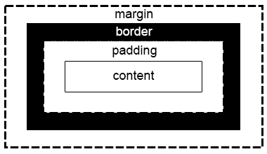
Every box is composed of four parts (or areas), defined by their respective edges:
The content area
Padding area
Border area
Margin area

Slide 63
PROPERTIES CONTROLLING THE SIZE OF THE BOX

Slide 64
PROPERTIES CONTROLLING THE SIZE
height
width
max-width
min-width
min-height
max-height

Slide 65
PROPERTIES CONTROLLING THE BORDER OF THE BOX

Slide 66
PROPERTIES CONTROLLING THE BORDER
border
border-color
border-style
Border-width
border-left
border-right
border-top
border-bottom
border-radius

Slide 67
DIFFERENCE BETWEEN MARGIN AND PADDING

Slide 68
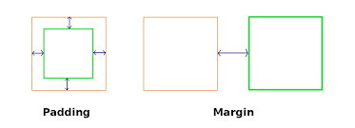

Slide 69
PROPERTIES CONTROLLING THE PADDING OF THE BOX

Slide 70
PROPERTIES CONTROLLING THE BORDER
padding
padding-left
padding-right
padding-top
padding-bottom

Slide 71
PROPERTIES CONTROLLING THE MARGIN OF THE BOX

Slide 72
PROPERTIES CONTROLLING THE MARGIN
margin
margin-left
margin-right
margin-top
margin-bottom

Slide 73
BLOCK, INLINE AND INLINE-BLOCK
BOXES

Slide 74
BLOCK BOXES
If a box is defined as a block, it will behave in the following ways:
The box will break onto a new line.
The box will extend in the inline direction to fill the space available in its container. In most cases this means that the box will become as wide as its container, filling up 100% of the space available.
The width and height properties are respected.
Padding, margin and border will cause other elements to be pushed away from the box

Slide 75
INLINE BOXES
The box will not break onto a new line.
The width and height properties will not apply.
Vertical padding, margins, and borders will apply but will not cause other inline boxes to move away from the box.
Horizontal padding, margins, and borders will apply and will cause other inline boxes to move away from the box.

Slide 76
INLINE BLOCK
An inline-block a middle ground between inline and block.
This is useful for situations where you do not want an item to break onto a new line, but do want it to respect width,height,margins,padding.
An element with display: inline-block does some of the below :
The width and height properties are respected.
padding, margin, and border will cause other elements to be pushed away from the box.
It does not, however, break onto a new line, and will only become larger than its content if you explicitly add width and height properties.

Slide 77
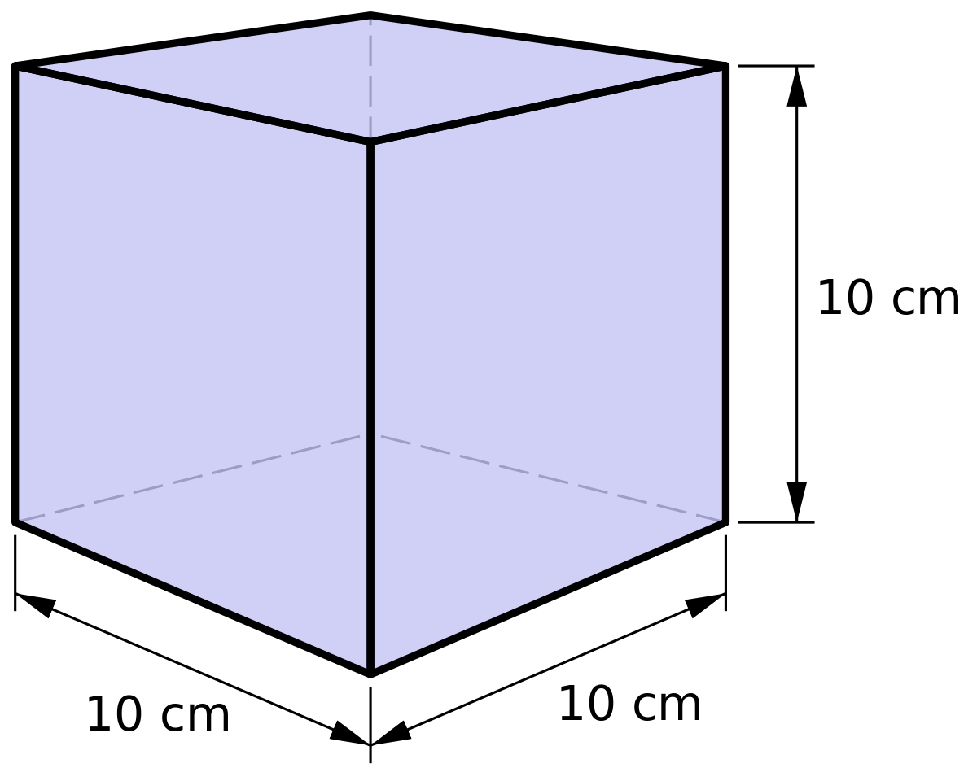
UNIT OF MEASUREMENTS

Slide 78
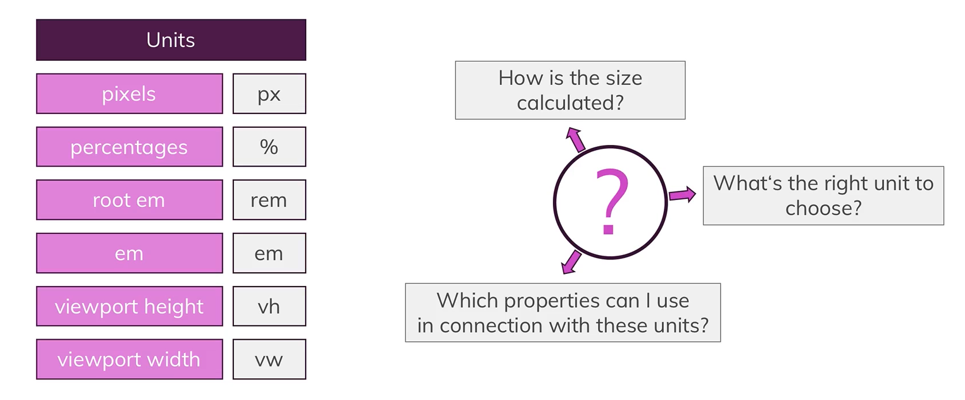

Slide 79
ABSOLUTE VS RELATIVE

Slide 80
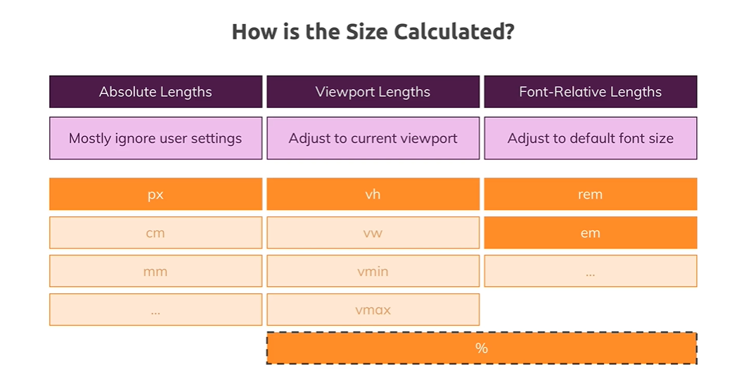

Slide 81
Relative Unit of Measurements
Unit | Relative to
% | % of it’s paren’t element
vh | 1% of the viewport's height.
vw | 1% of the viewport's width.
fr | a fraction of the available space in the grid container.
rem | Font size of the root element.

Slide 82
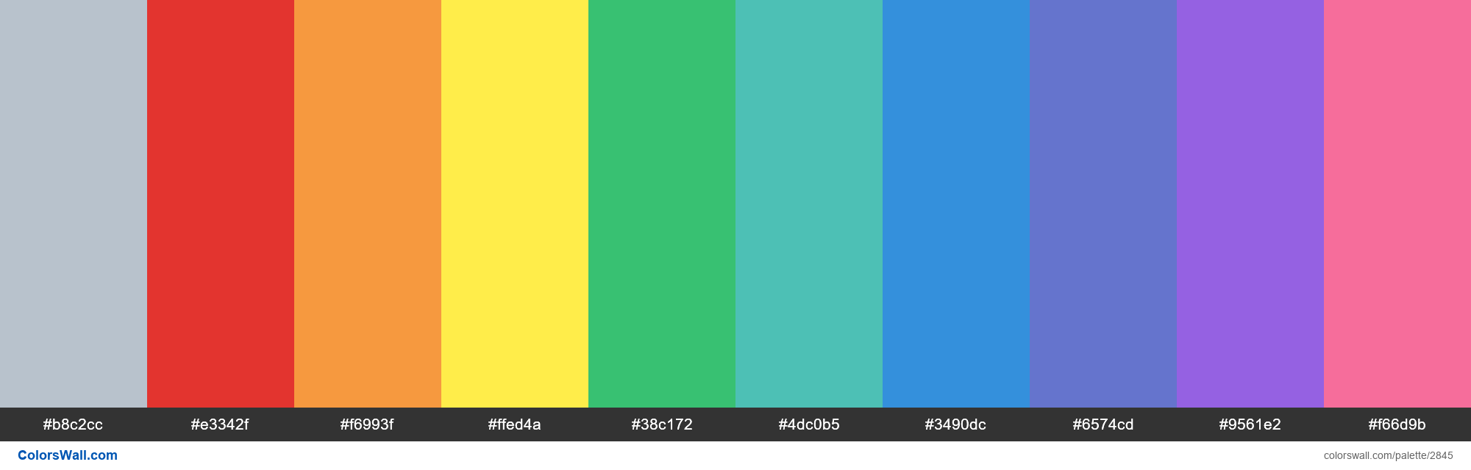
COLORS

Slide 83
The popular ways of applying colors
By color names
As RGB values
As hexadecimal values

Slide 84
NAME COLORS

Slide 85
NAME COLORS
All modern browsers support the following 140 color names.
Example :
Red
Blue
Green
Yellow
ETC

Slide 86
RGB COLORS

Slide 87
RGB COLORS
RGB color values are supported in all browsers.
An RGB color value is specified with: rgb( RED , GREEN , BLUE ).
Each parameter defines the intensity of the color as an integer between 0 and 255.
For example, rgb(0,0,255) is rendered as blue, because the blue parameter is set to its highest value (255) and the others are set to 0.

Slide 88
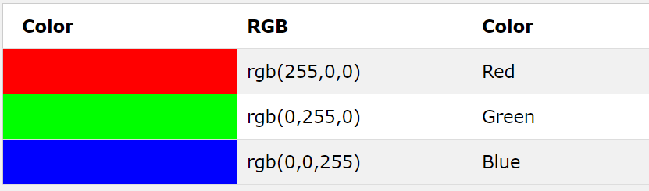
RGB COLORS
.

Slide 89
RGBA COLORS

Slide 90

RGBA COLORS
RGBA color values are an extension of RGB color values with an alpha channel - which specifies the opacity of the color.
Alpha defines the opacity as a number between 0.0 (fully transparent) and 1.0 (fully opaque

Slide 91
HEXADECIMAL COLORS

Slide 92
HEXADECIMAL COLORS
Hexadecimal color values are supported in all browsers
A hexadecimal color is specified with: #RRGGBB.
RR (red), GG (green) and BB (blue) are hexadecimal integers between 00 and FF specifying the intensity of the color.
For example, #0000FF is displayed as blue, because the blue component is set to its highest value (FF) and the others are set to 00.

Slide 93
BACKGROUND IMAGES
The background images are drawn on stacking context layers on top of each other. The first layer specified is drawn as if it is closest to the user.

Slide 94

This is an example of a background image

Slide 95

This is an example of an image

Slide 96
BACKGROUND IMAGES VS IMG

Slide 97
BACKGROUND-IMAGE VS IMG
Images bring semantic value to a website, and adding the alt tag makes it super accessible and interpreted by all user agents and screen readers
A background image plays a decorative role in your website, it doesn’t come with any semantic meaning or add any complementary value to the subject.
If your image is a part of the content of the page then it belongs in the html using <img src=""> So for example, you might have images to show off in your portfolio. These images are the main point of your page and you would want them in the html as part of the overall structure/content of the page.
If on the other hand, the image exists for stylistic purposes as part of the design and isn't an essential image then it should be in the css as a background image. As an example, this could be some banner type image that you might have as a background in your header. Or just any other type of image that might be there to make it look better.

Slide 98
PROPERTIES CONTROLLING THE BORDER
background-image
Background-repeat
Background-position
background-size
background-attachment

Slide 99
THE END

